Slide 1
How to get an authtoken
SWC-OhiO-2025
Secure Programming with Python
Profs. David Singletary & Pamela Brauda

Slide 2
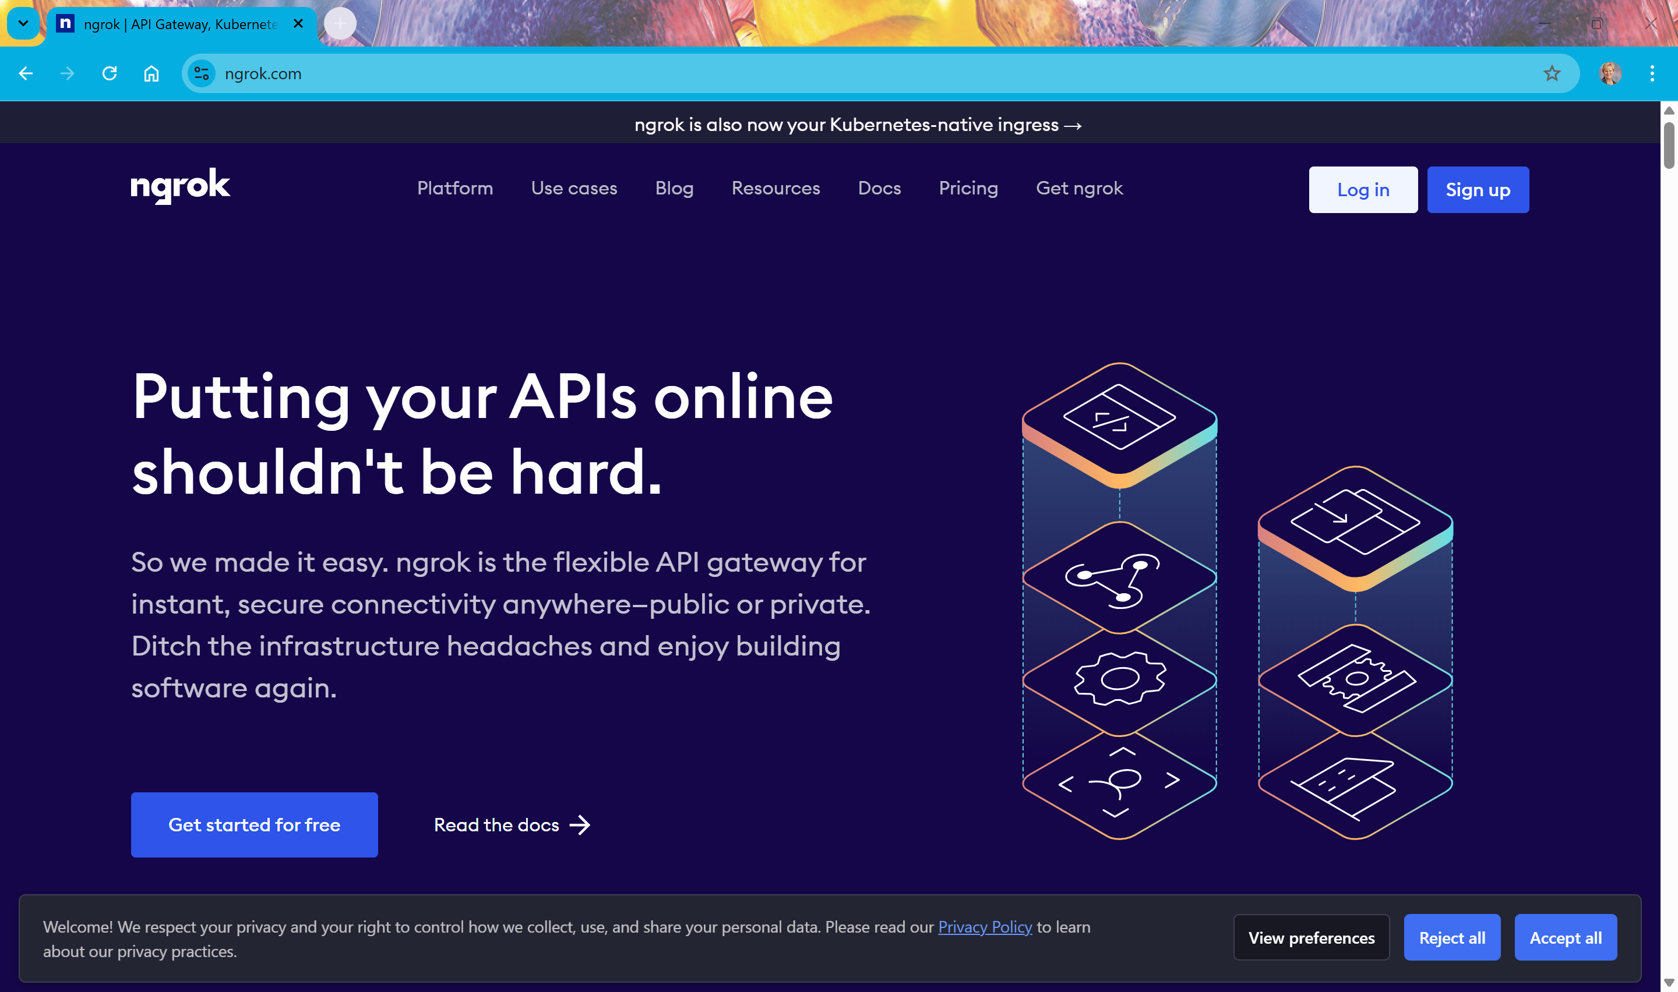
ngrok.com
Notes:
Go to ngrok.com
Click on the Sign up button in the upper right corner

Slide 3
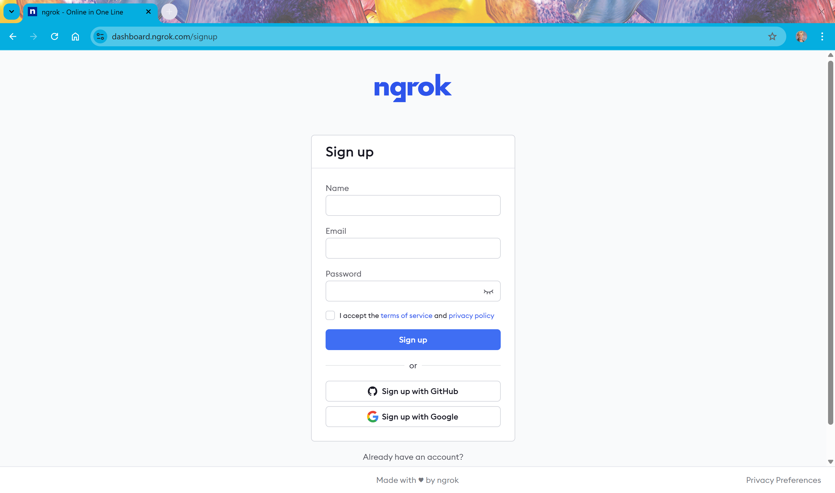

Slide 4
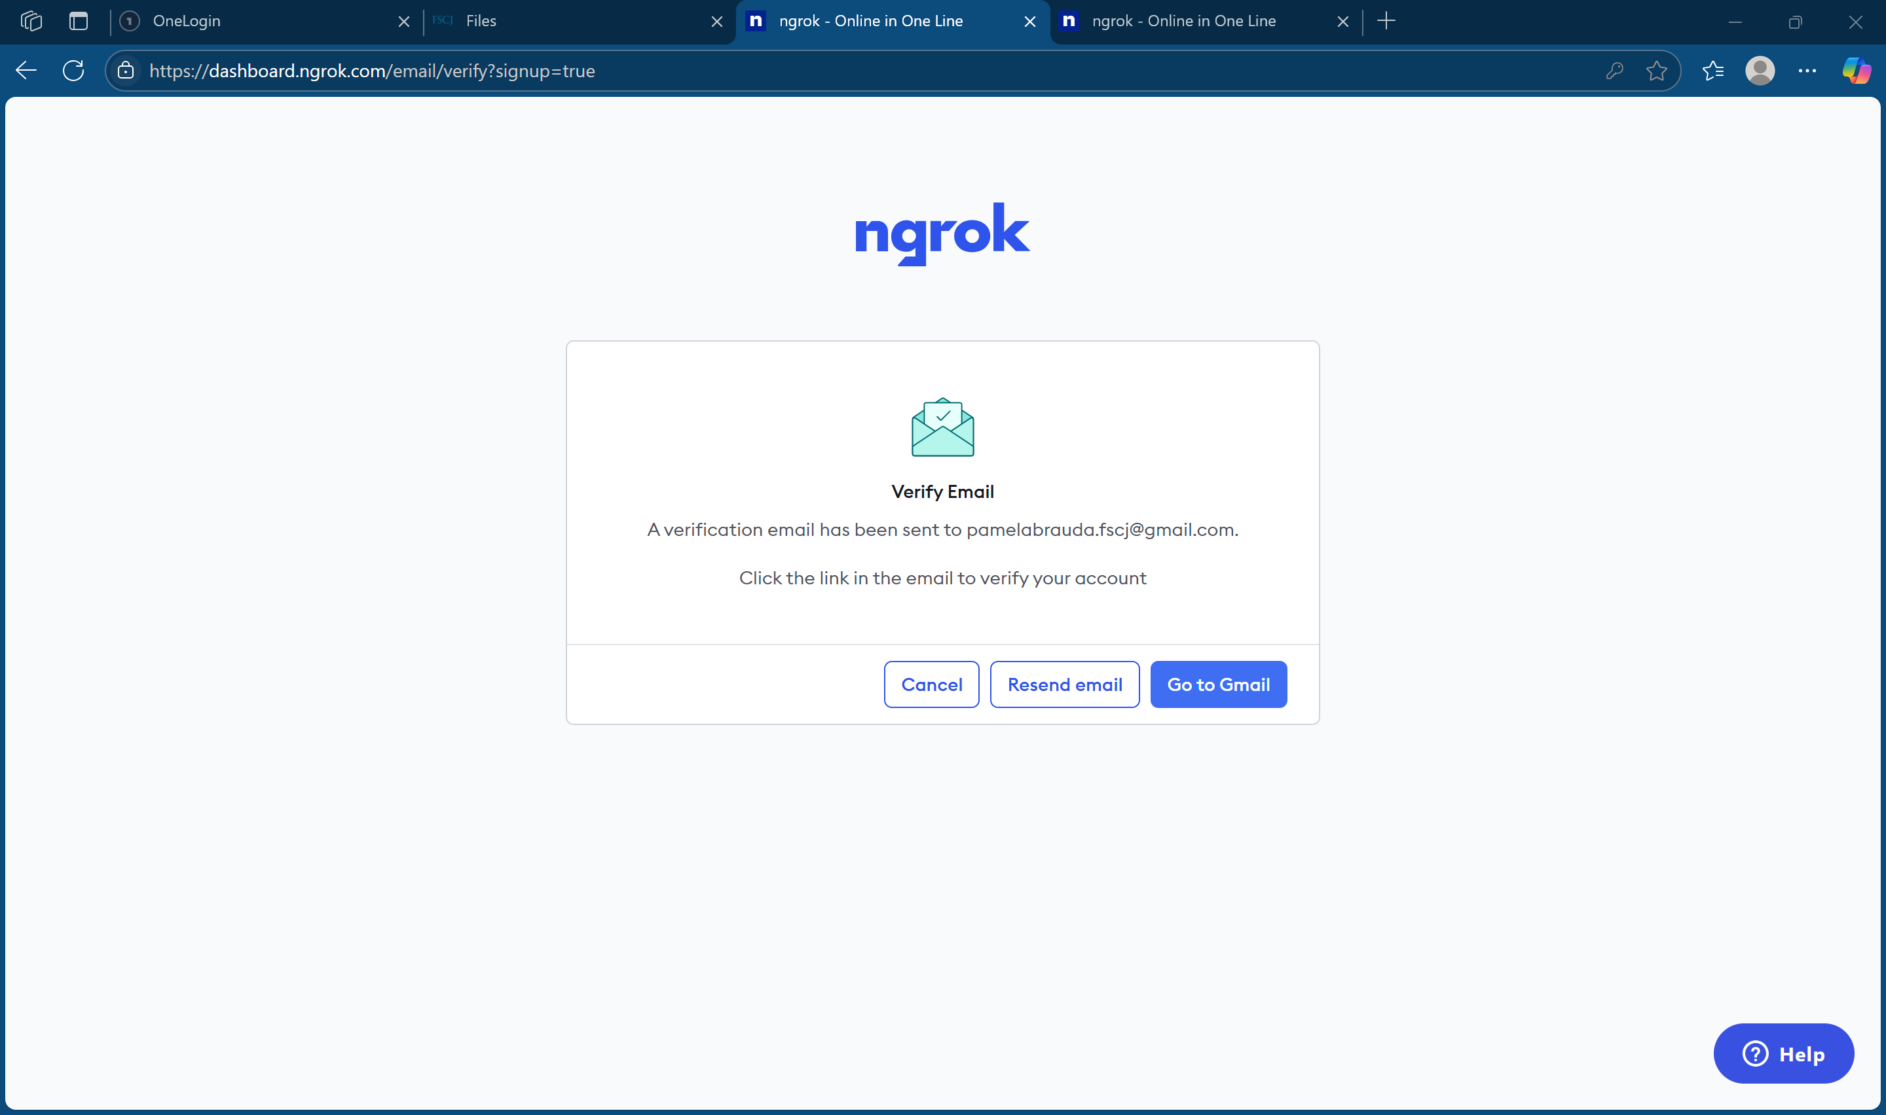

Slide 5
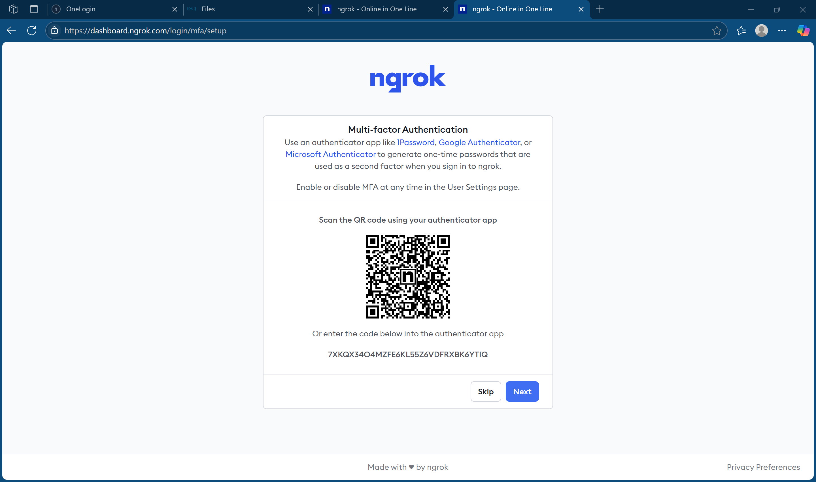
Notes:
I used Google Authenticator
Click the Next button

Slide 6
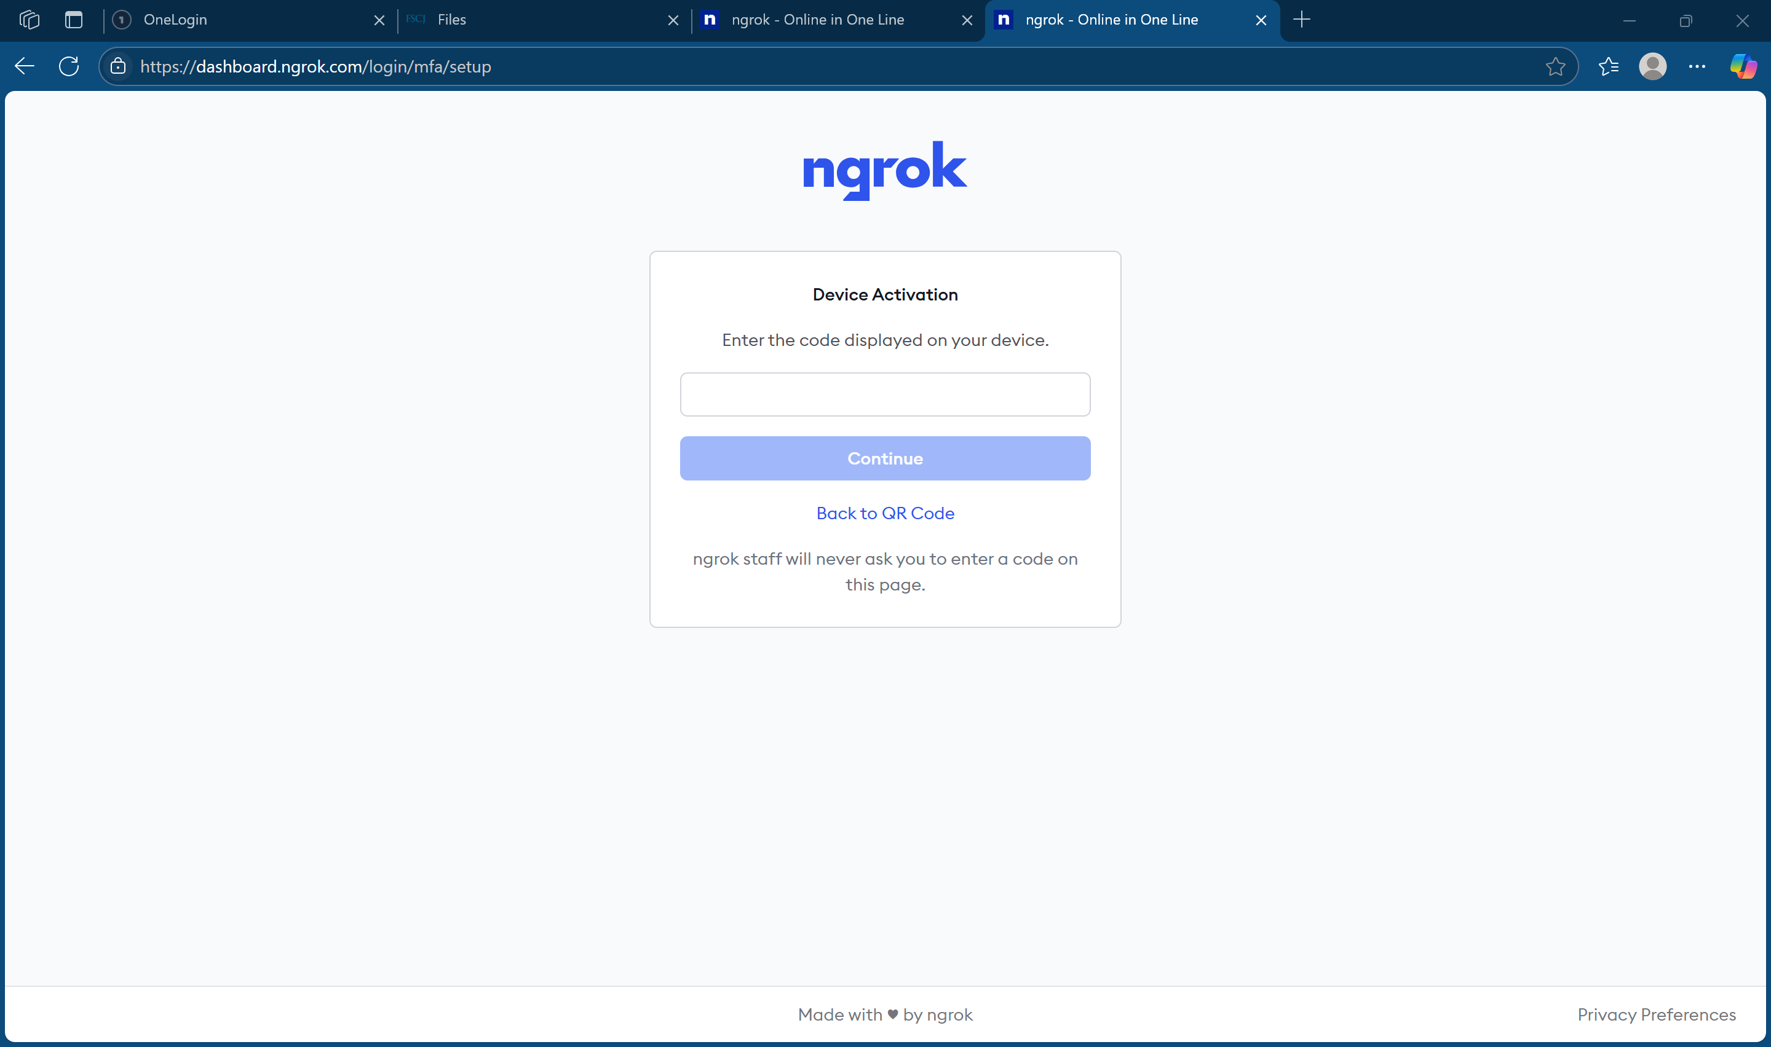

Slide 7
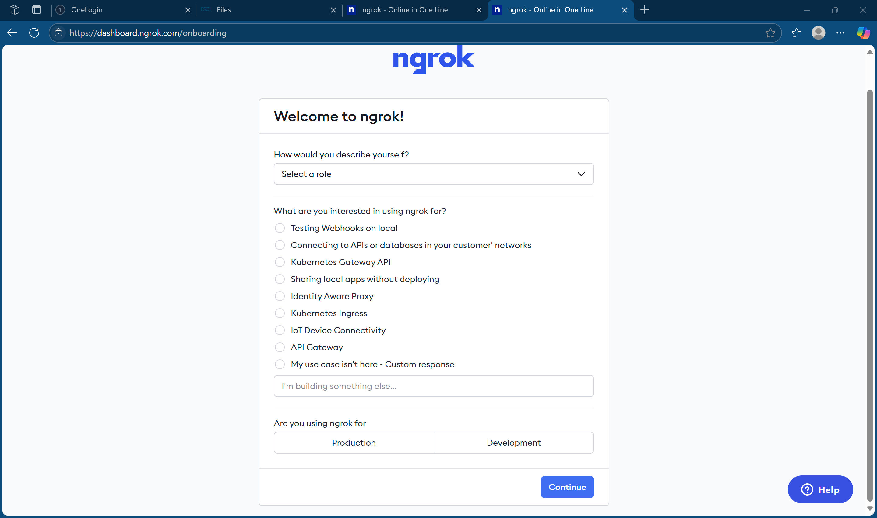
Notes:
I selected Student/Hobbyist
Select any use
I selected Development

Slide 8
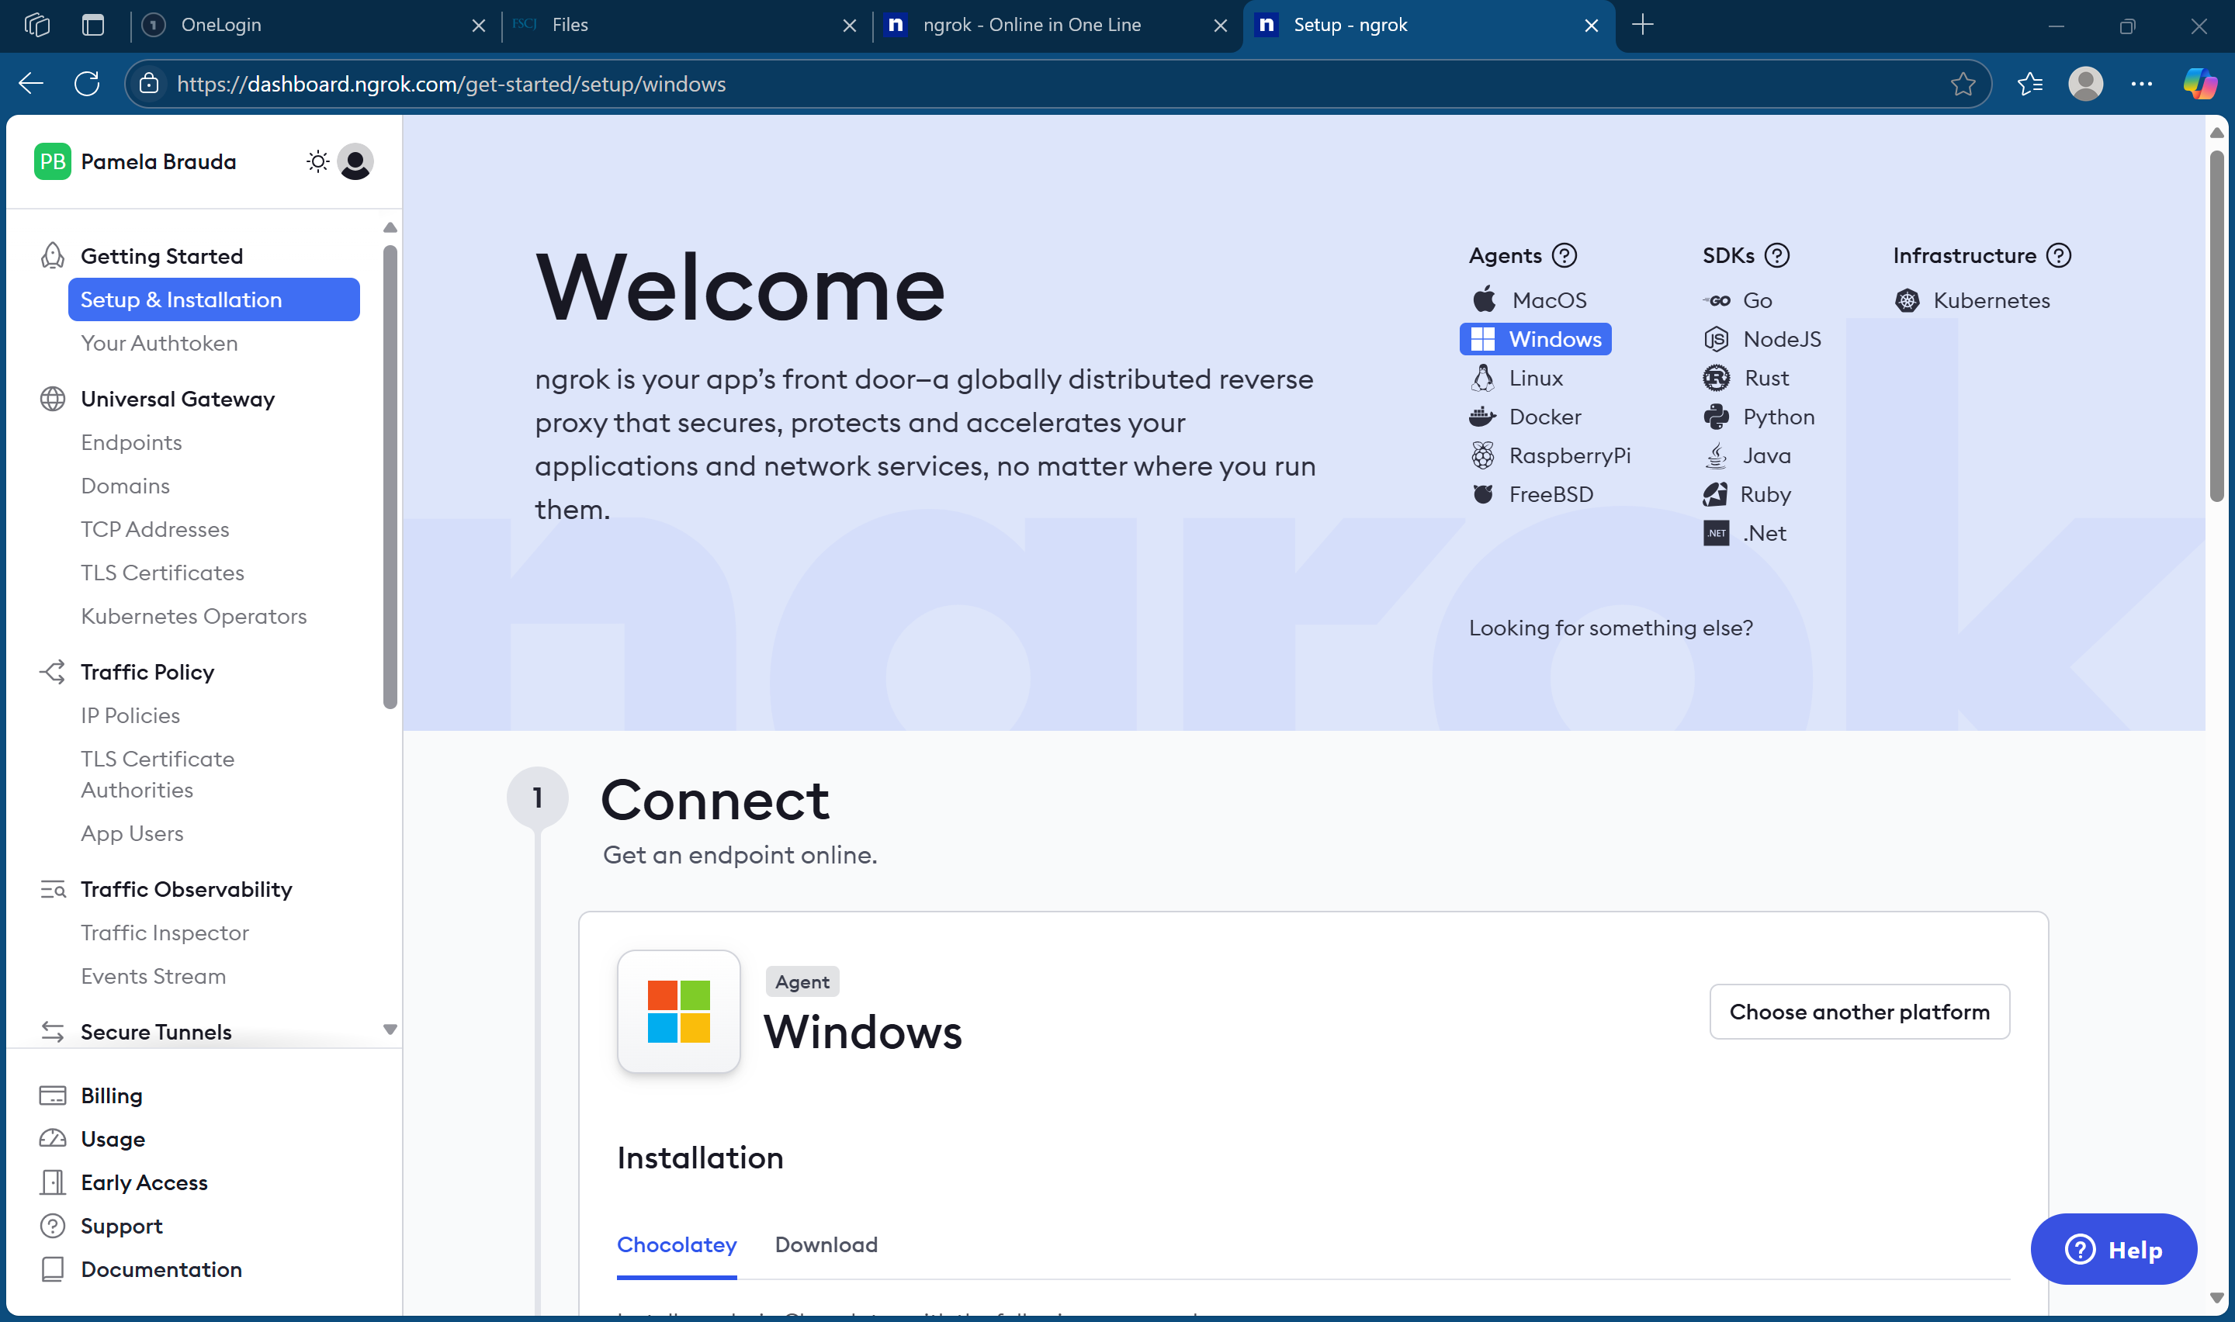
Select Your Authtoken
Notes:
Select Your Authtoken in the left menu under Getting Started

Slide 9
